Slide 1
A linked list is a linear data structure that includes a series of connected nodes
Each node consists of a data value and a pointer that points to the next node
The list element can be easily inserted or removed without reallocation or reorganization of the entire structure
Random access of elements is not a feasible and accessing an element has linear time complexity
The linked list data structure supports three main operations
Insertion – to add an element at the beginning, end or at a given index in the list
Deletion – to remove an item its index or value
Search – to find an element given its value
Linked list usage – all applications of both stacks and queues are applicable of linked list ex. Image viewer

Slide 2
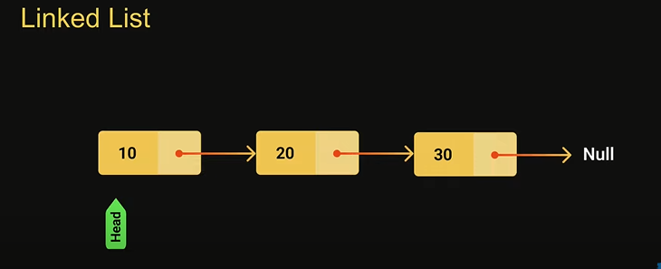
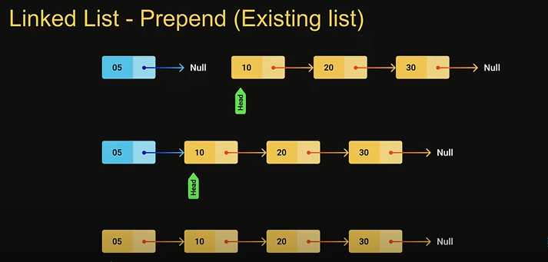
Prepend (Empty List)
We have to create a new node that will be added to the list. The node will contain a value and pointer pointing at null
Next we will handle the scenario where the list might be empty to begin with if the list is empty we have to make the head point at the newly created node the head pointer should always point at the first node in the list
This we will make the newly created node point at the head node and make h=the newly added node as the head of the list it will ensure the connectivity between the newly added node and the existing node

Slide 3
Print ()
We are going to begin by creating a temporary pointer called curr to traverse the list curr will point at the head node since head is the first node in the list. We will then use next pointer in each node to traverse the list. So current will be equal to current node. Next which will give us access to the second node whose value can be printed this will continue for all the nodes till null.
Append()
Step one we have create a new node that will be added to the list. A node will contain a value and a next pointer pointing at null
If the list is empty to begin with we have to am the head point at the newly created node. remember the head poi should always point at the first node
If the list contains previous nodes head is pointing at the first node each nodes point at the next node and last node points at the null. To add a new node at the end make the last node in the list point at the newly created node. the way to reach the last node contains a logic similar to method which we had the only difference if that instead of making current pointer cross the last node in the list at null we stop exactly at the last node in the list we make use of previous pointer and advance it till we reach the you do end up to the last node this will effectively append the existing list

Slide 4
Insert(invalid index) the index will lie in the range of 0 to size of the linked list.
In the first scenario(index < 0) index is less than zero or greater than the size of the list in such scenario we simply return from the function
In the second scenario(index = 0) is where the index is equal to zero inserting the new node as the first node in the list inserting the new node at the beginning is same as appending
The third scenario( index > 0 ) in this case we have to add a new node in the middle of the list now whenever we have to do something that is not at the head of the list it generally involves a temporary pointer that moves across the list to insert an element at the given index we need to get hold of the node previous to that index insertion is as simple as changing next pointer to individual node
remove()
In the first scenario is where the index is less than zero or greater than the size of the list in such case we return null as no element can be removed.
In the second scenario(index = 0) is removing the head node which is the first node in the list removing the head node involves pointing head at the second node in the in terms of code head would point to its own new pointer which always points at the second node in the list the first node is detached and garbage collected.
The third scenario( index > 0 ) in this case we have to remove a new node in the middle of the list we have to make the node at position one point directly to the node position at 3 that will effectively detach node at poition 2 from the the list

Slide 5
Remove(node and value)
In the first scenario remove he node from the list give its value the first method removes the first node that contains the value it will return the value remove or null if the node was not found.
In the second scenario is where the passed in value is equal to value of the first node in the list hat is removing the head node it involves pointing head to the second node in the list
Final scenario remove the value in node after the head(random) we will start at the previous pointing at the head node then traverse the list advancing the previous pointer till we reach the node that is previous to the node that contains the value
Search()
In search we find a node given its value for implementation we will return the first index or position at which the value is present
The first scenario is where the list is empty in such a case we return -1 as no node present
In the second scenario the when the list is not empty we return the index of that node. We create a var for the index and a pointer names current to traverse the list current will point at the head node to begin with. We will then use he next pointer to each node to advance the current pointer and check if the node contains the search value and return the index value.

Slide 6
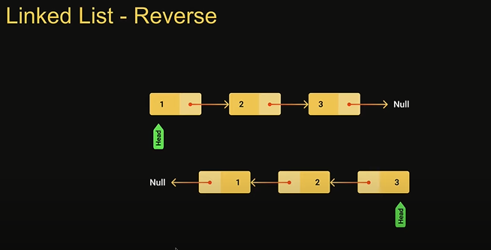
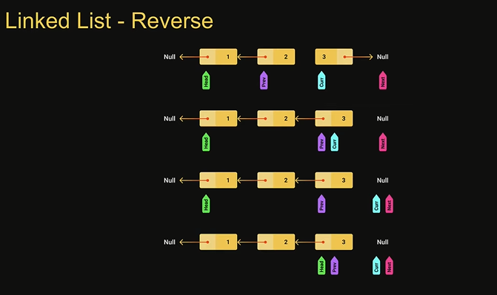
Reverse Linked List
We will create 2 temporary pointers previous which points at null current which points at head.
first we will create temporary pointer called next and point it to current.next we then set current.next to previous.
Next points at current.next, current .next points at previous.next repeat the process again

Slide 7
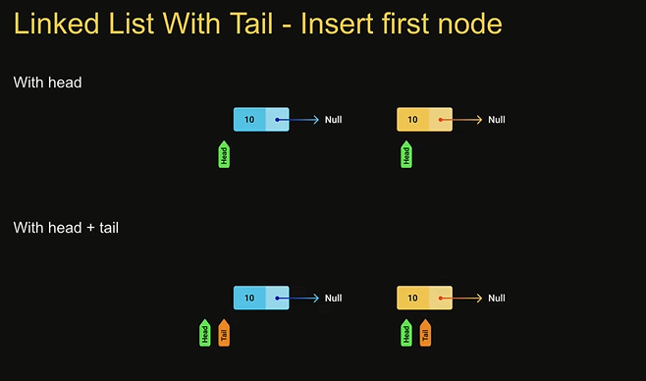
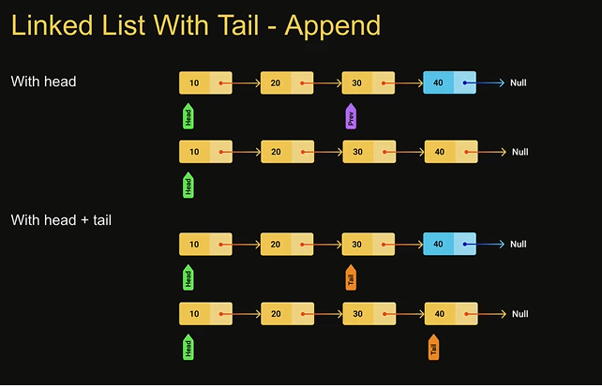
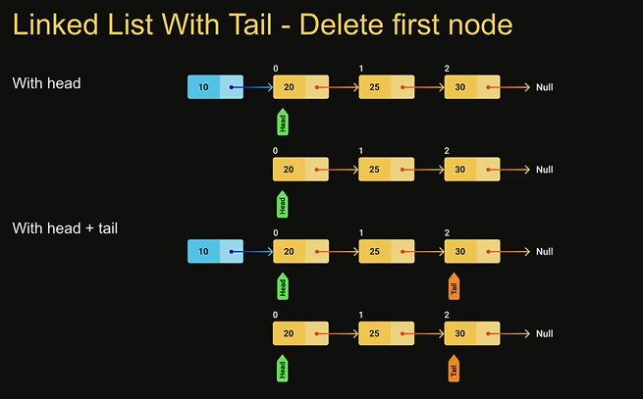
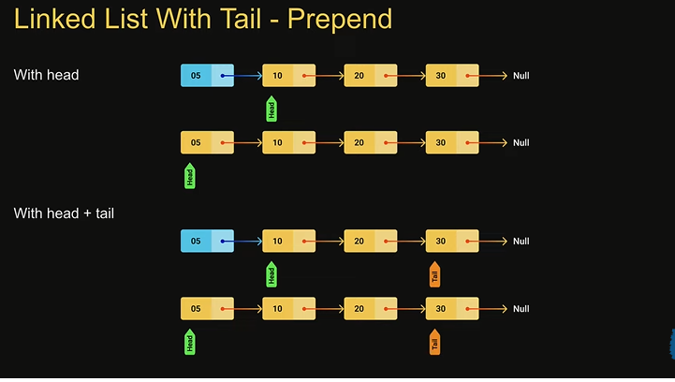
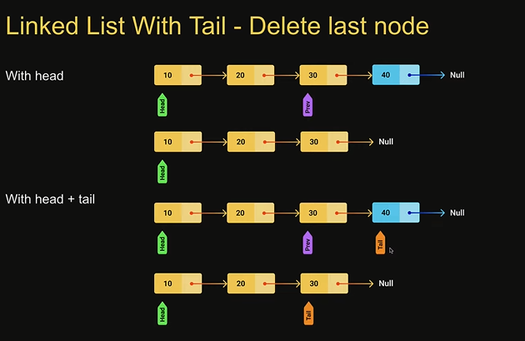
Linked list tail overview

Slide 8
